Slide 1
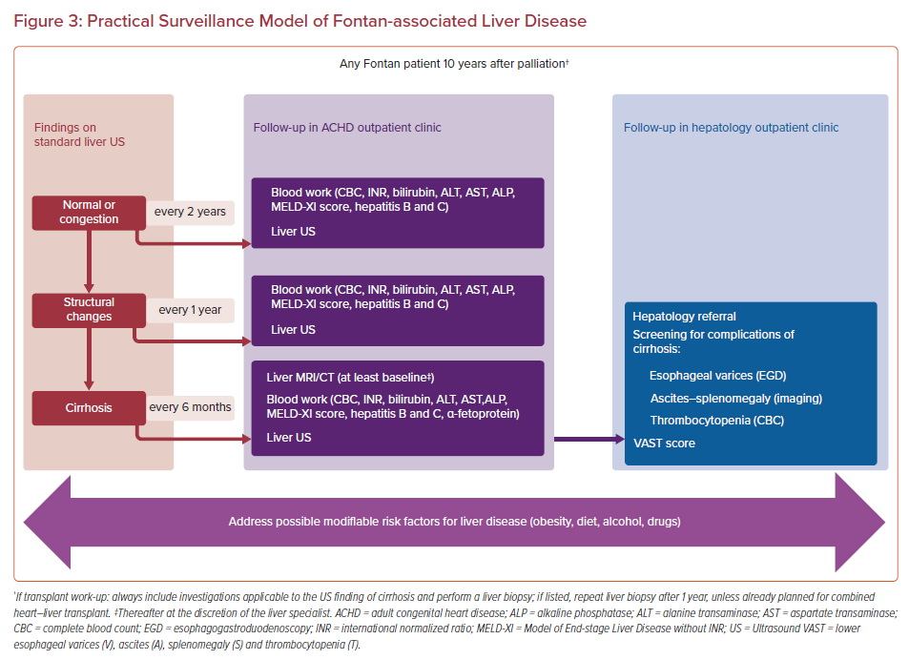
Cieplucha A, Budts W, Gewillig M, Bruaene AVD
Practical Surveillance Model of Fontan-associated Liver Disease
Citation: US Cardiology Review 2022;16:e25.
https://doi.org/10.15420/usc.2022.02

