Slide 1
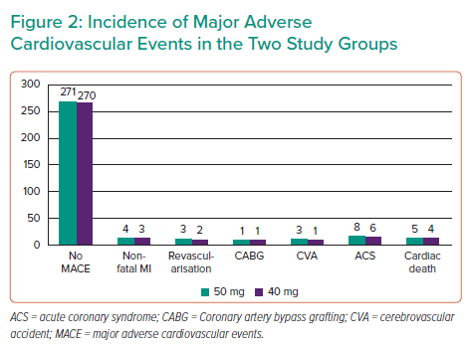
Chehrevar M, Vafa RG, Rahmani M, Parizi MM, Ahmadi A, Zamiri B, Heydarzadeh R, Montaser M, Hosseini SA, Kojuri J
Incidence of Major Adverse Cardiovascular Events in the Two Study Groups
Citation: Interventional Cardiology 2022;17:e20.
https://doi.org/10.15420/icr.2022.13

