Slide 1
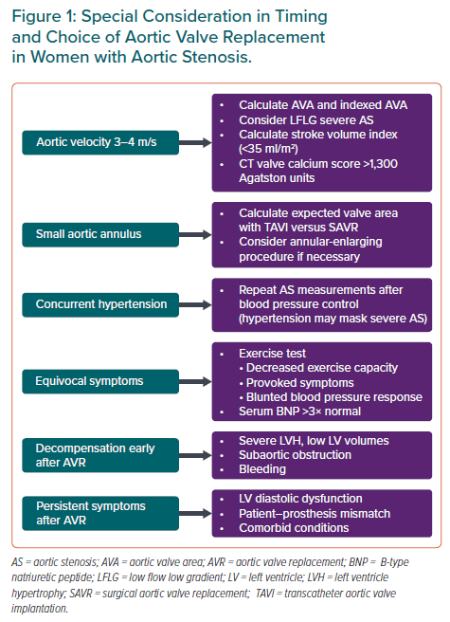
Rashedi N, Otto CM
Special Consideration in Timing and Choice of Aortic Valve Replacement in Women with Aortic Stenosis
Citation: European Cardiology Review 2022;17:e25.
https://doi.org/10.15420/ecr.2022.31

