Slide 1

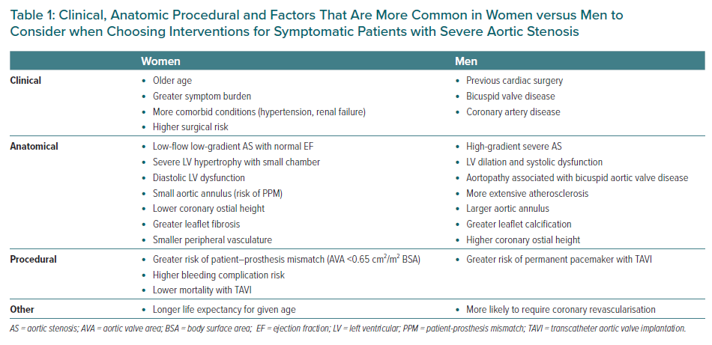
Rashedi N, Otto CM
Clinical, Anatomic Procedural and Factors That Are More Common in Women versus Men to Consider when Choosing Interventions for Symptomatic Patients with Severe Aortic Stenosis
Citation: European Cardiology Review 2022;17:e25.
https://doi.org/10.15420/ecr.2022.31

