Slide 1
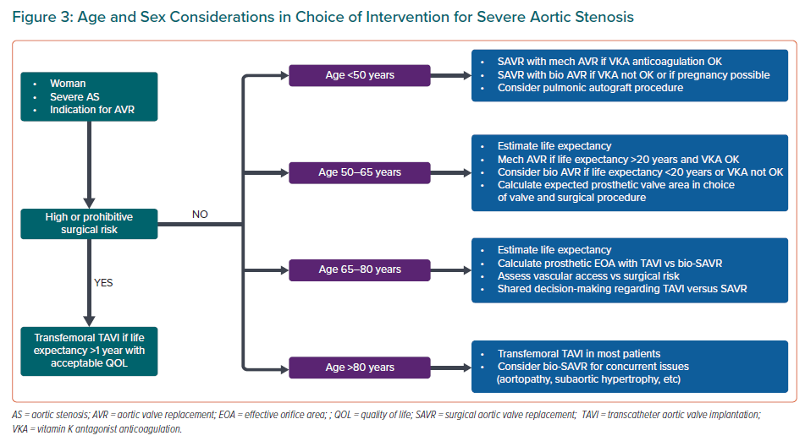
Rashedi N, Otto CM
Age and Sex Considerations in Choice of Intervention for Severe Aortic Stenosis
Citation: European Cardiology Review 2022;17:e25.
https://doi.org/10.15420/ecr.2022.31

