Slide 1
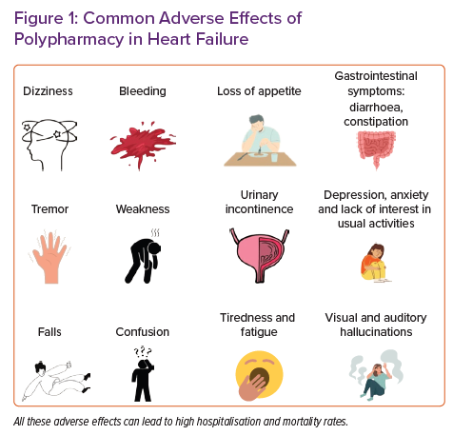
Stefil M, Dixon M, Bahar J, Saied S, Mashida K, Heron O, Shantsila E, Walker L, Akpan A, Lip GY, Sankaranarayanan R
Common Adverse Effects of Polypharmacy in Heart Failure
Citation: Cardiac Failure Review 2022;8:e34.
https://doi.org/10.15420/cfr.2022.14

