Slide 1
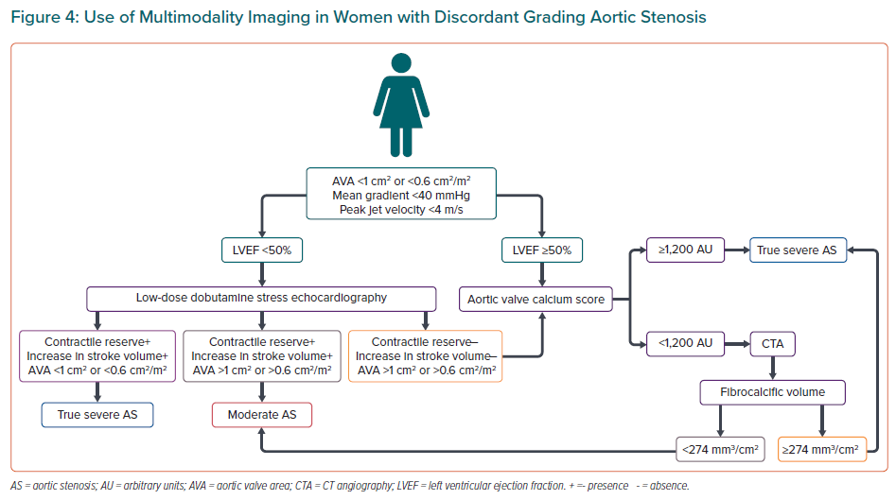
Singh GK, Delgado V
Use of Multimodality Imaging in Women with Discordant Grading Aortic Stenosis
Citation: European Cardiology Review 2022;17:e26.
https://doi.org/10.15420/ecr.2022.26

