Slide 1

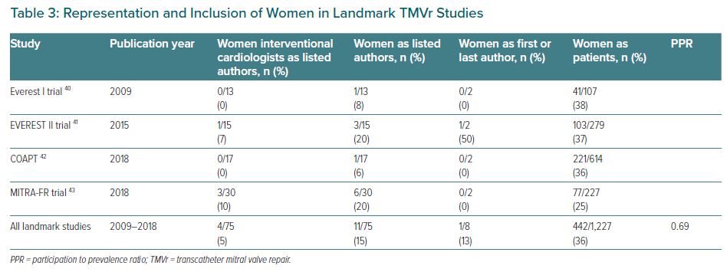
Burgess S, Cader FA, Shaw E, Banerjee S, Stehli J, Krishnamorthy R, Khor L, Forotan H, Bastiany A, Rao S, Chandrasekhar J, Zaman S, Alasnag M, Chieffo A, Coylewright M
Representation and Inclusion of Women in Landmark TMVr Studies
Citation: European Cardiology Review 2022;17:e27.
https://doi.org/10.15420/ecr.2022.33

