Slide 1
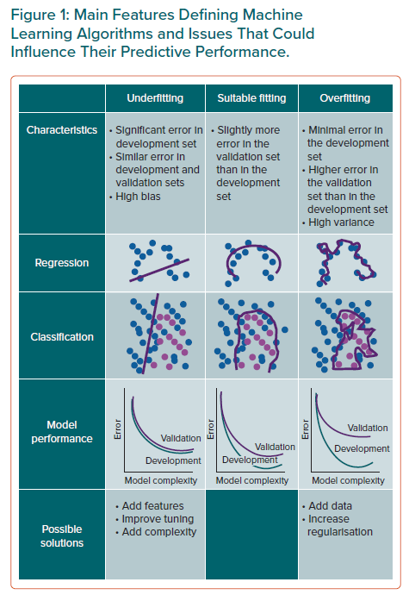
Chiarito M, Luceri L, Oliva A, Stefanini GG, Condorelli G
Main Features Defining Machine Learning Algorithms and Issues That Could Influence Their Predictive Performance
Citation: European Cardiology Review 2022;17:e29.
https://doi.org/10.15420/ecr.2022.11

