Slide 1
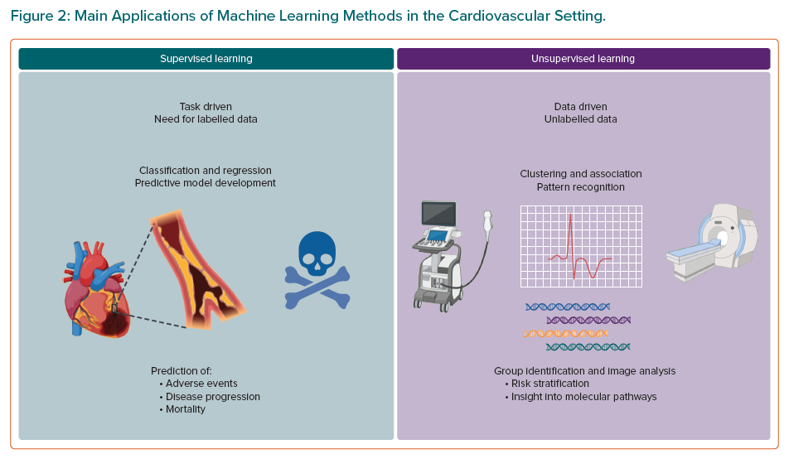
Chiarito M, Luceri L, Oliva A, Stefanini GG, Condorelli G
Main Applications of Machine Learning Methods in the Cardiovascular Setting
Citation: European Cardiology Review 2022;17:e29.
https://doi.org/10.15420/ecr.2022.11

