Slide 1
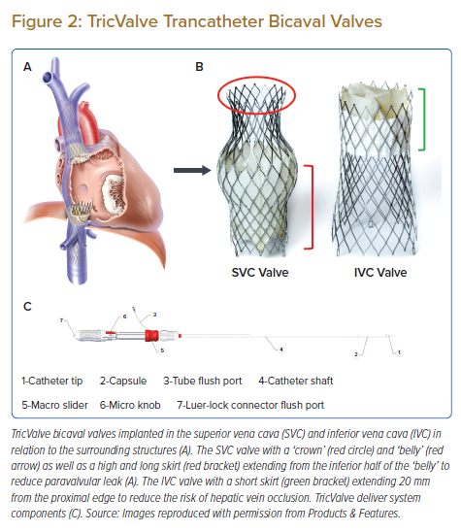
Wong N, Jappar IA, Ho JS, Ewe SH, Tan SY, Tan JWC, Sin KYK, Yeo KK
TricValve Trancatheter Bicaval Valves
Citation: Journal of Asian Pacific Society of Cardiology 2022;1:e29.
https://doi.org/10.15420/japsc.2022.11

