Slide 1
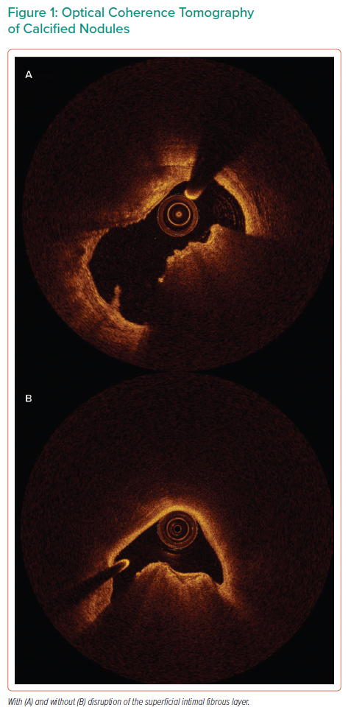
Fitzgerald S, Gimenez MR, Allali A, Toelg R, Sulimov DS, Geist V, Kastrati A, Thiele H, Richardt G, Abdel-Wahab M
Optical Coherence Tomography of Calcified Nodules
Citation: Interventional Cardiology 2023;18:e02.
https://doi.org/10.15420/icr.2022.07

