Slide 1
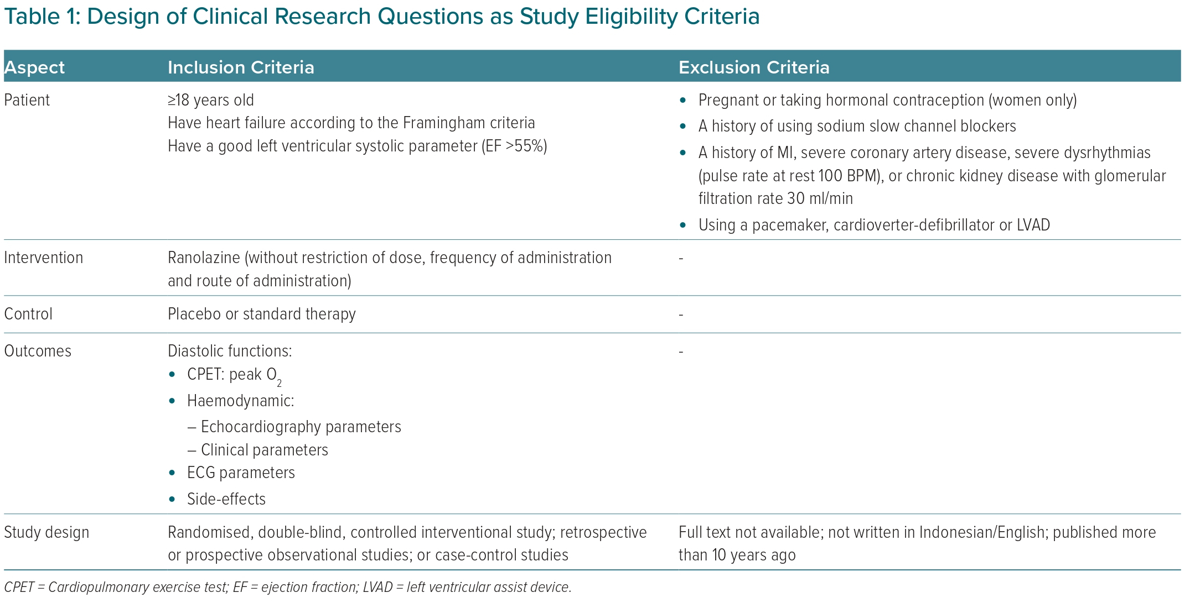
Cempaka Putri DKS, Andrianto A, Al-Farabi MJ, Saputra PBT, Nugraha RA
Design of Clinical Research Questions as Study Eligibility Criteria
Citation: European Cardiology Review 2023;18:e02.
https://doi.org/10.15420/ecr.2022.10

