Slide 1
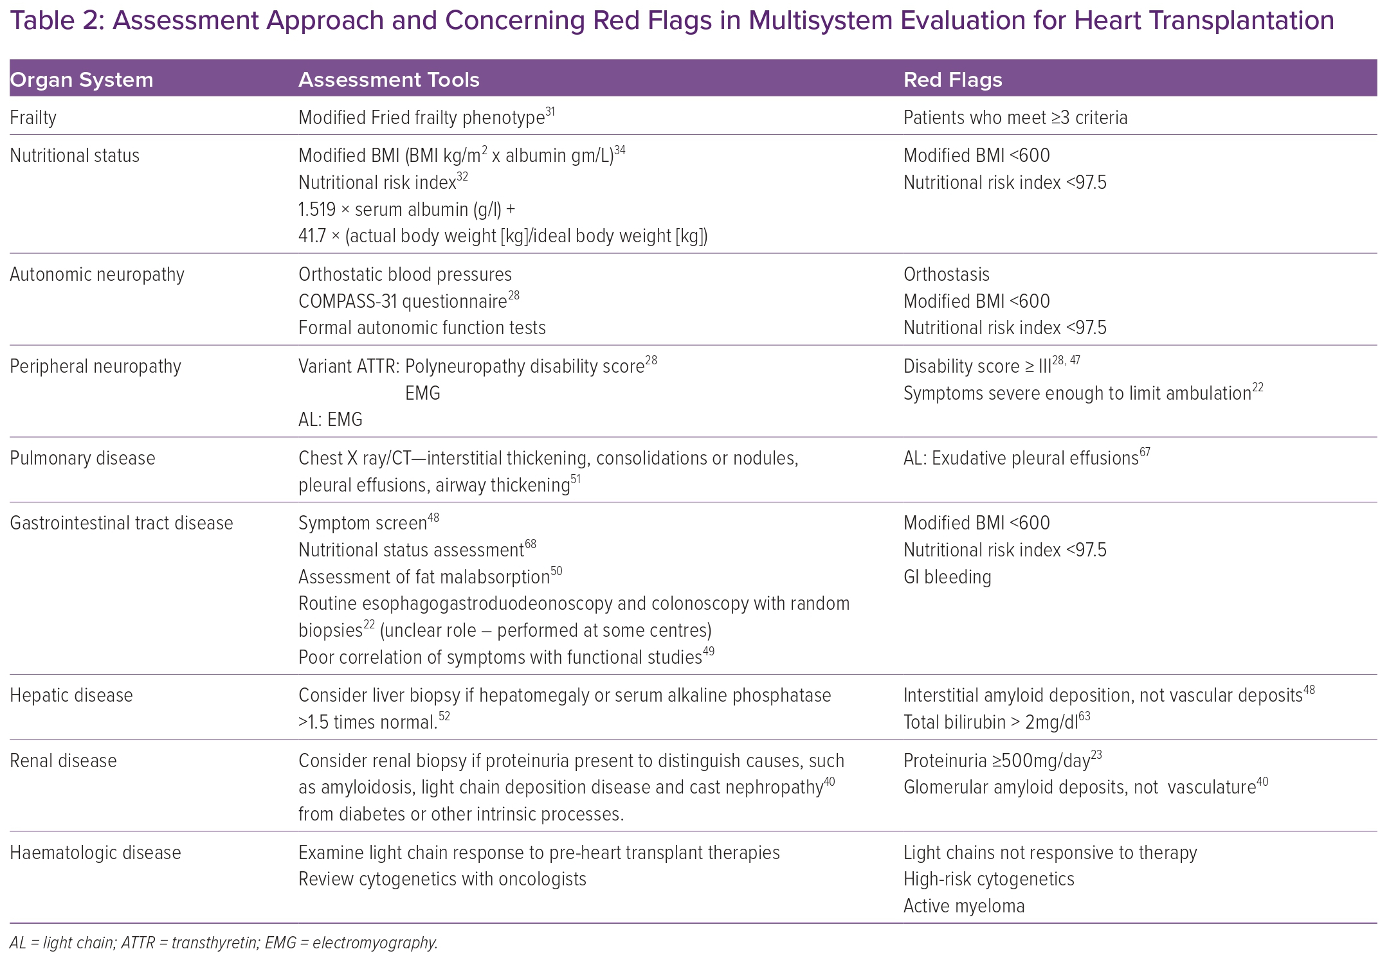
Punnoose LR, Siddiqi H, Rosenthal JL, Kittleson M, Witteles R, Alexander K
Assessment approach and concerning red flags in multisystem evaluation for heart transplantation
Citation: Cardiac Failure Review 2023;9:e01.
https://doi.org/10.15420/cfr.2022.24

