Slide 1
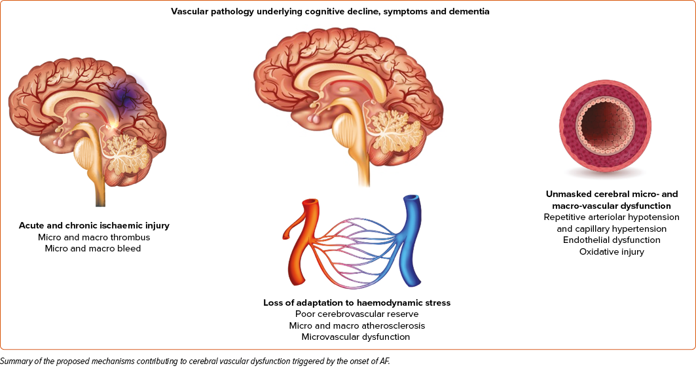
Zenger B, Rizzi S, Steinberg BA, Ranjan R, Bunch TJ
Proposed Mechanisms of Cerebral Vascular Dysfunction Due to Atrial Fibrillation
Citation: Arrhythmia & Electrophysiology Review 2023;12:e01.
https://doi.org/10.15420/aer.2022.29

