Slide 1
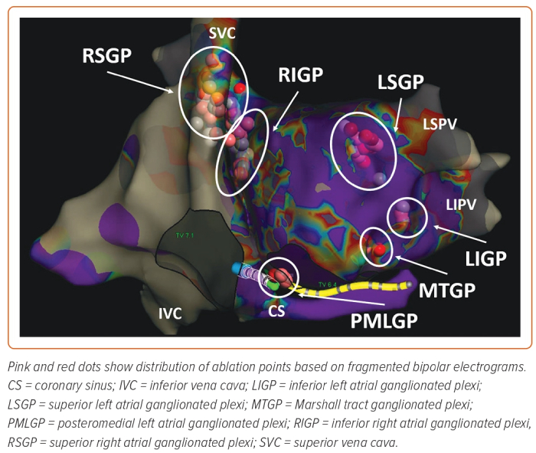
Aksu T, Skeete JR, Huang HH
Figure 2: The Schematic View of Ganglionated Plexi
Citation: Arrhythmia & Electrophysiology Review 2023;12:e02.
https://doi.org/10.15420/aer.2022.37

