Slide 1
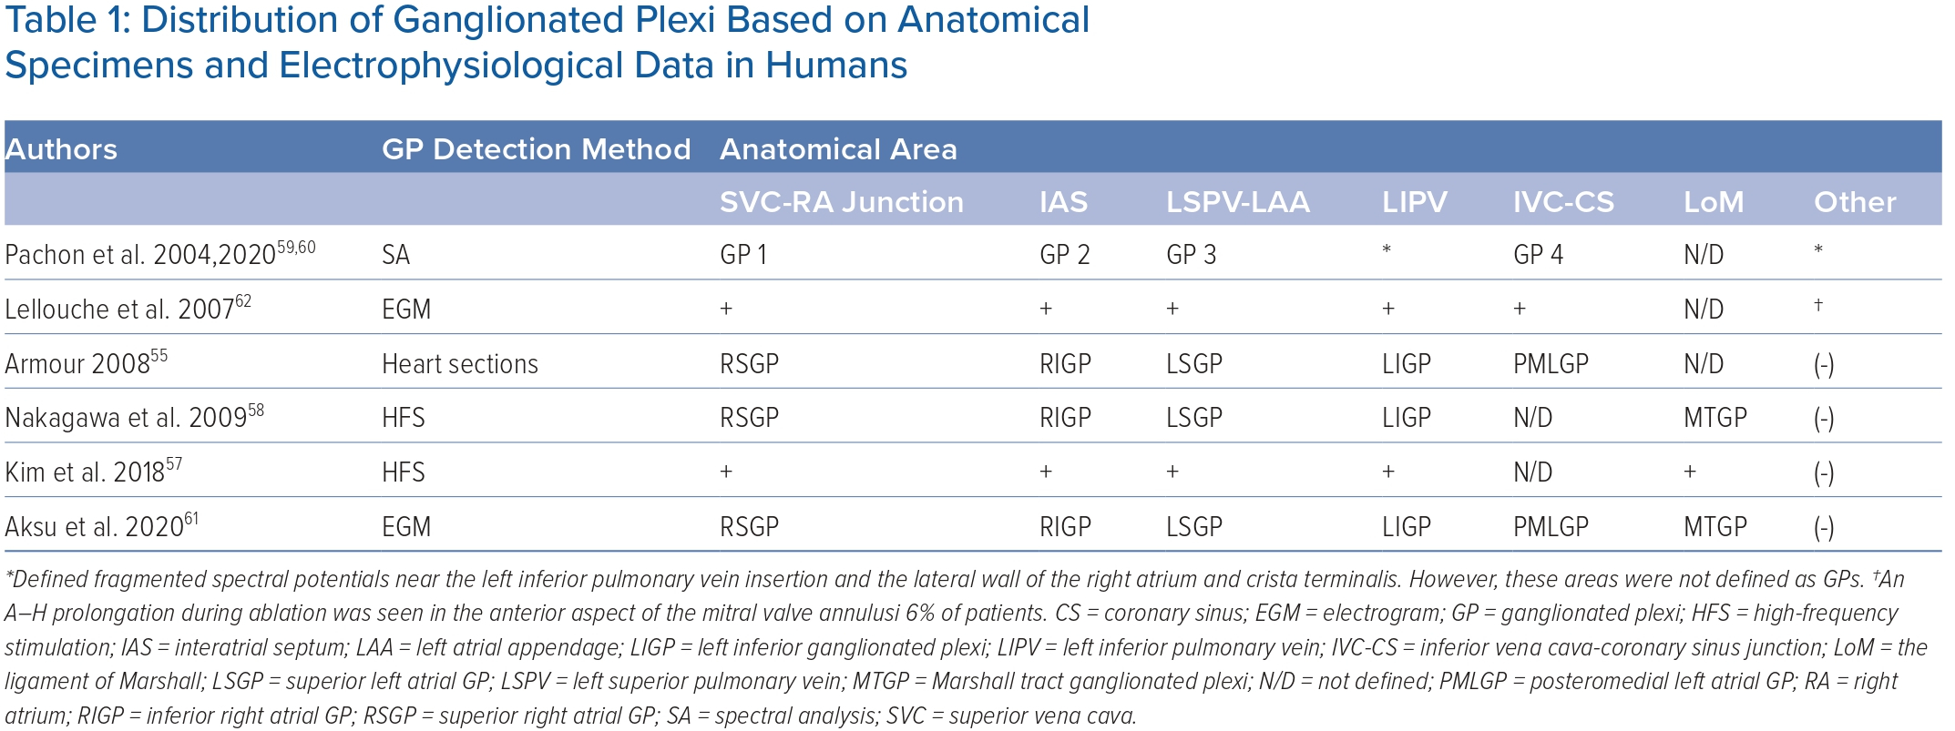
Aksu T, Skeete JR, Huang HH
Distribution of Ganglionated Plexi Based on Anatomical Specimens and Electrophysiological Data in Humans
Citation: Arrhythmia & Electrophysiology Review 2023;12:e02.
https://doi.org/10.15420/aer.2022.37

