Slide 1
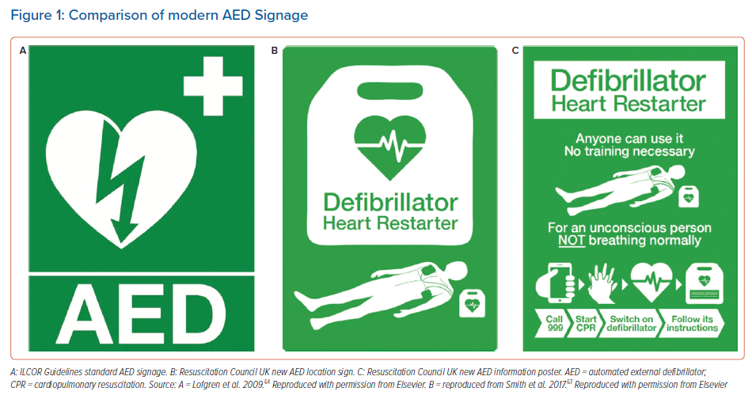
Bassi MD, Farina JM, Bombau J, Maurice MF, Bortman G, Nuñez E, Márquez M, Bornancin N, Baranchuk A
Comparison of modern AED Signage
Citation: Arrhythmia & Electrophysiology Review 2023;12:e03.
https://doi.org/10.15420/aer.2022.30

