Slide 1
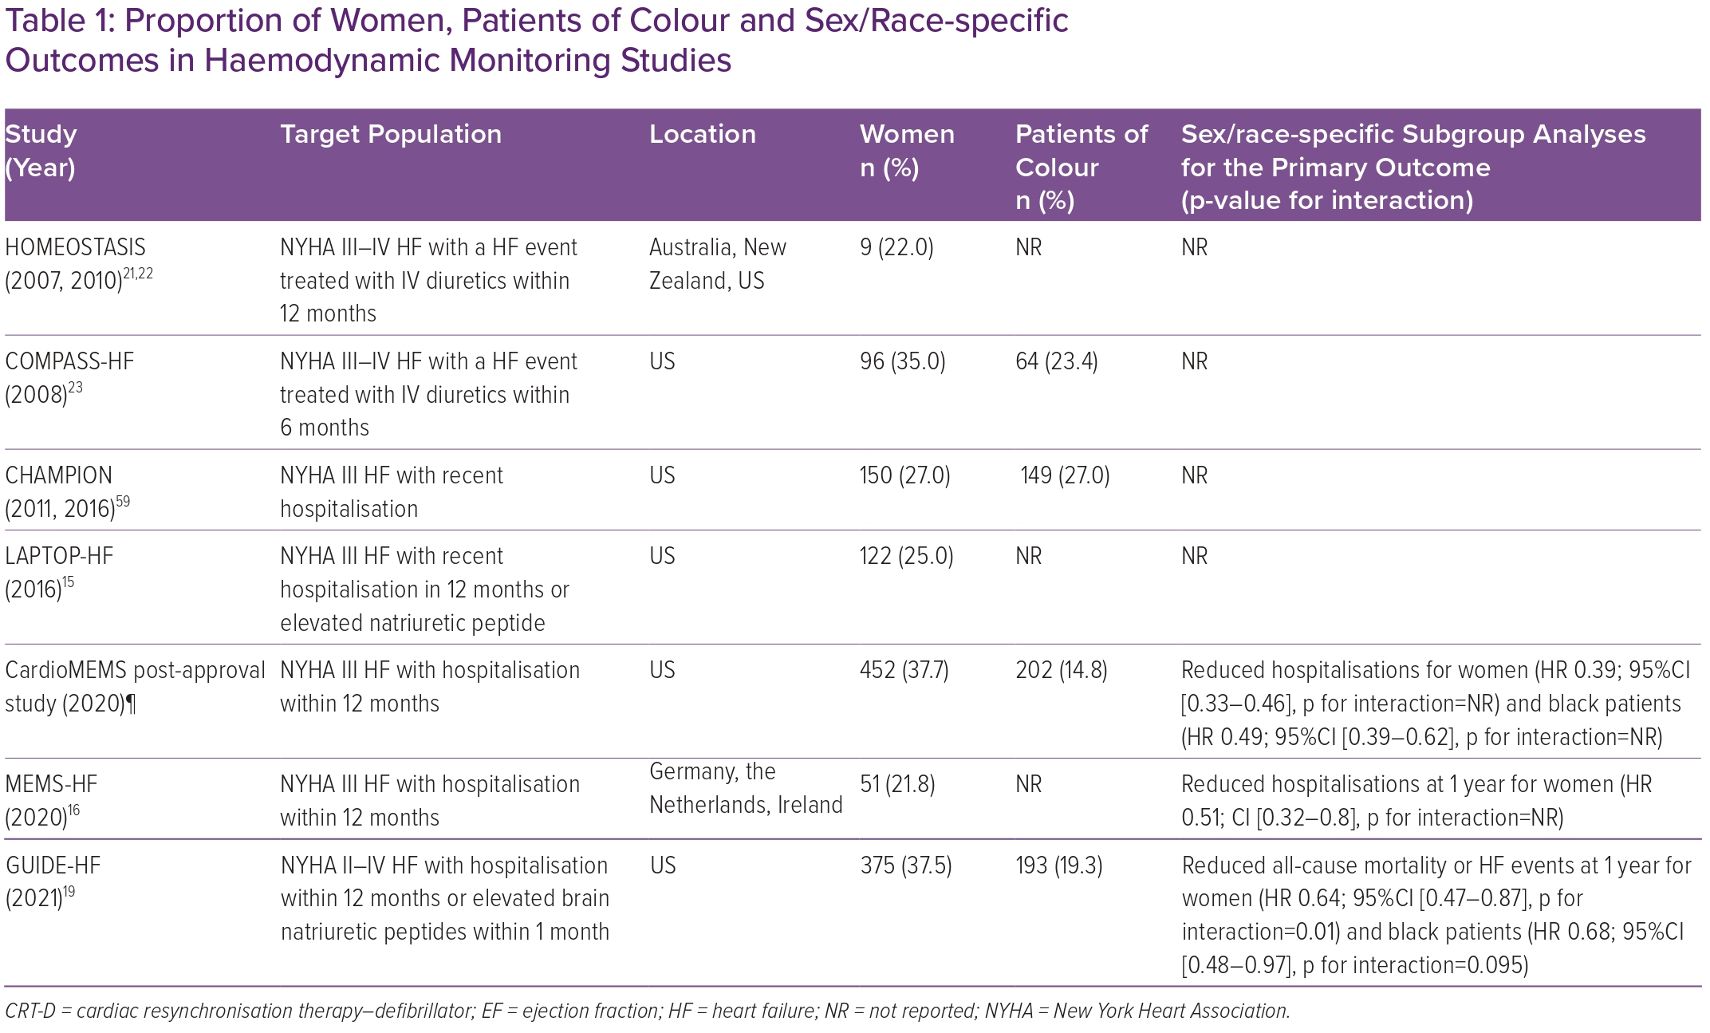
Mastoris I, DeFilippis EM, Martyn T, Morris AA, Van Spall H, Sauer AJ
Proportion of Women, Patients of Colour and Sex/Race-specific Outcomes in Haemodynamic Monitoring Studies
Citation: Cardiac Failure Review 2023;9:e02.
https://doi.org/10.15420/cfr.2022.22

