Slide 1
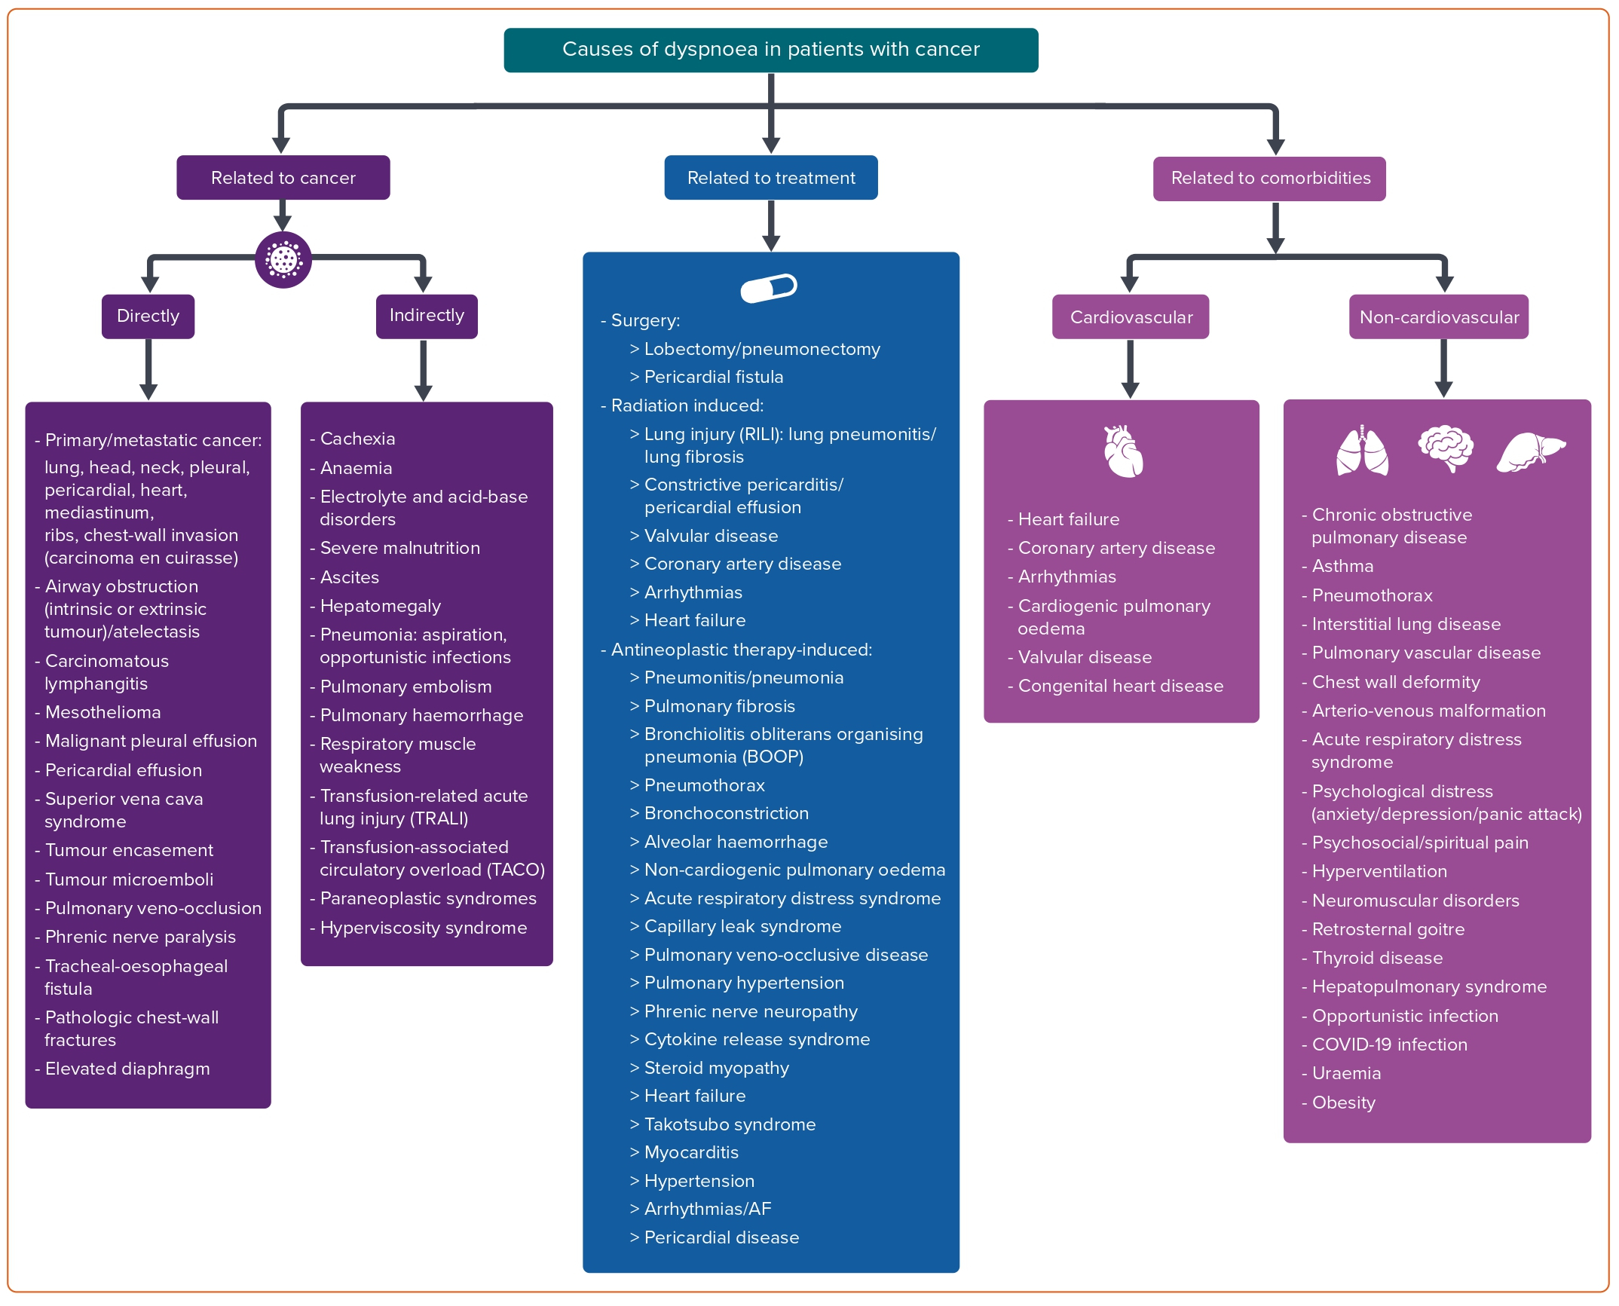
Keramida K, Kostoulas A
Figure 1: Causes of Dyspnoea in Patients with Cancer
Citation: European Cardiology Review 2023;18:e03.
https://doi.org/10.15420/ecr.2021.62

