Slide 1
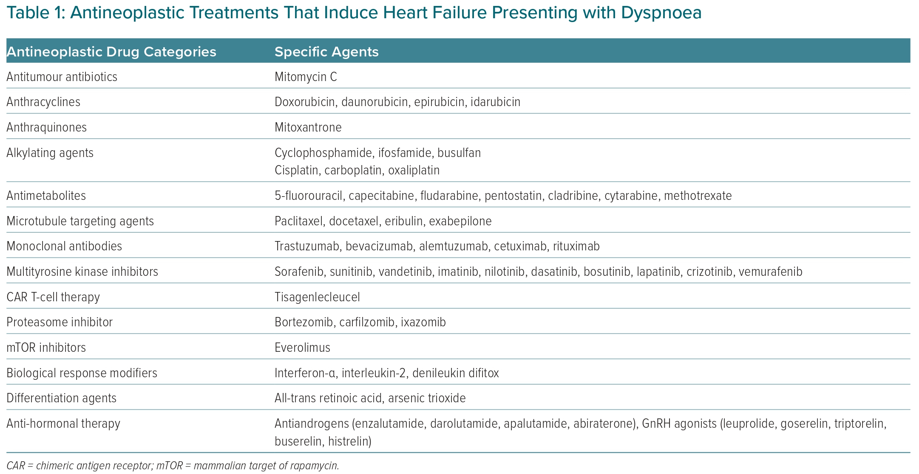
Keramida K, Kostoulas A
Antineoplastic Treatments That Induce Heart Failure Presenting with Dyspnoea
Citation: European Cardiology Review 2023;18:e03.
https://doi.org/10.15420/ecr.2021.62

