Slide 1

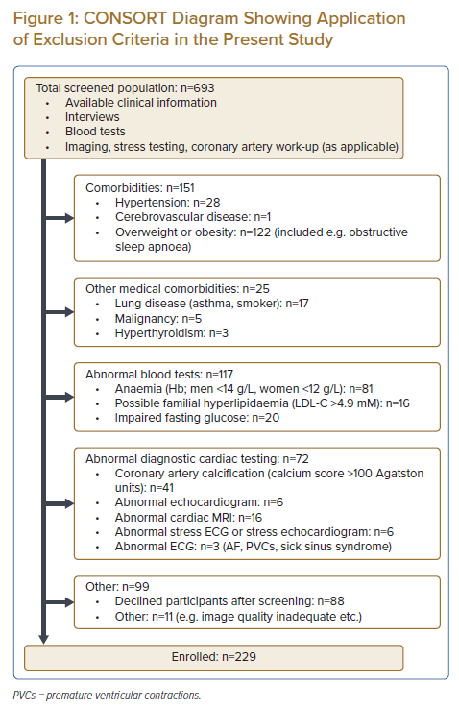
Sahlén A, Teo MT, Hamid N, Huang W, Agpaoa ADR, Ruan W, Ewe SH, Yeo KK, Ding ZP
CONSORT Diagram Showing Application of Exclusion Criteria in the Present Study
Citation: Journal of Asian Pacific Society of Cardiology 2023;2:e02.
https://doi.org/10.15420/japsc.2021.30

