Slide 1
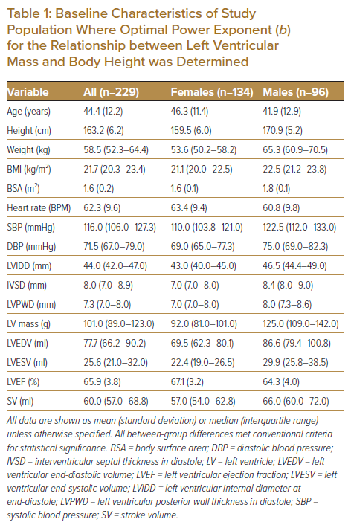
Sahlén A, Teo MT, Hamid N, Huang W, Agpaoa ADR, Ruan W, Ewe SH, Yeo KK, Ding ZP
Baseline Characteristics of Study Population Where Optimal Power Exponent (b) for the Relationship between Left Ventricular Mass and Body Height was Determined
Citation: Journal of Asian Pacific Society of Cardiology 2023;2:e02.
https://doi.org/10.15420/japsc.2021.30

