Slide 1
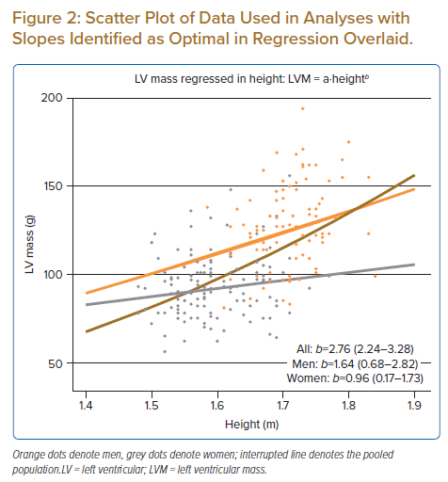
Sahlén A, Teo MT, Hamid N, Huang W, Agpaoa ADR, Ruan W, Ewe SH, Yeo KK, Ding ZP
Scatter Plot of Data Used in Analyses with Slopes Identified as Optimal in Regression Overlaid.
Citation: Journal of Asian Pacific Society of Cardiology 2023;2:e02.
https://doi.org/10.15420/japsc.2021.30

