Slide 1
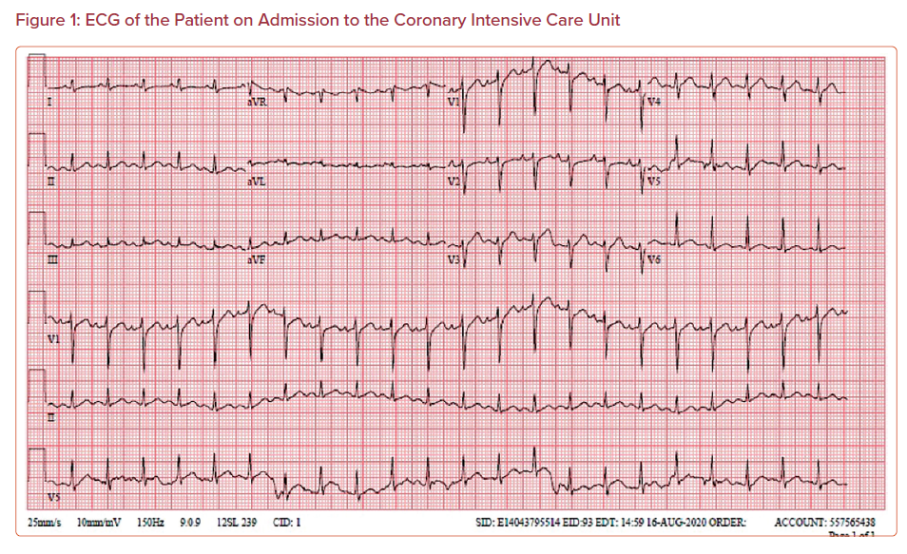
Hariri E, Scandinaro A, Hammoud MMA, Kasper A, Parris C, Bakhtadzi B, Higgins A
ECG of the Patient on Admission to the Coronary Intensive Care Unit
Citation: US Cardiology Review 2023;17:e01.
https://doi.org/10.15420/usc.2022.22

