Slide 1
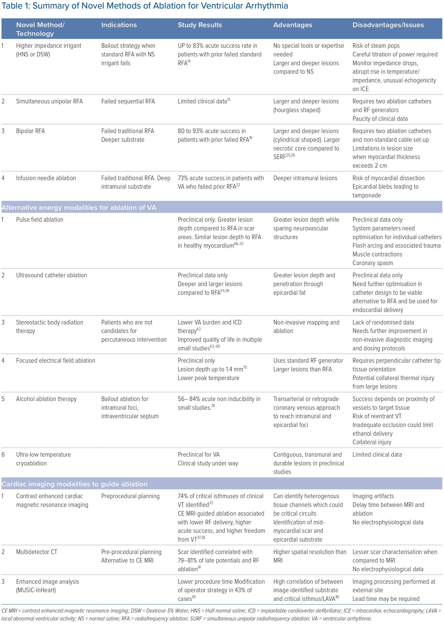
Ravi V, Winterfield J, Liang JJ, Larsen T, Dye C, Sanders D, Skeete J, Payne J, Trohman RG, Aksu T, Sharma PS, Huang HD
Summary of Novel Methods of Ablation for Ventricular Arrhythmia
Citation: Arrhythmia & Electrophysiology Review 2023;12:e04.
https://doi.org/10.15420/aer.2022.28

