Slide 1
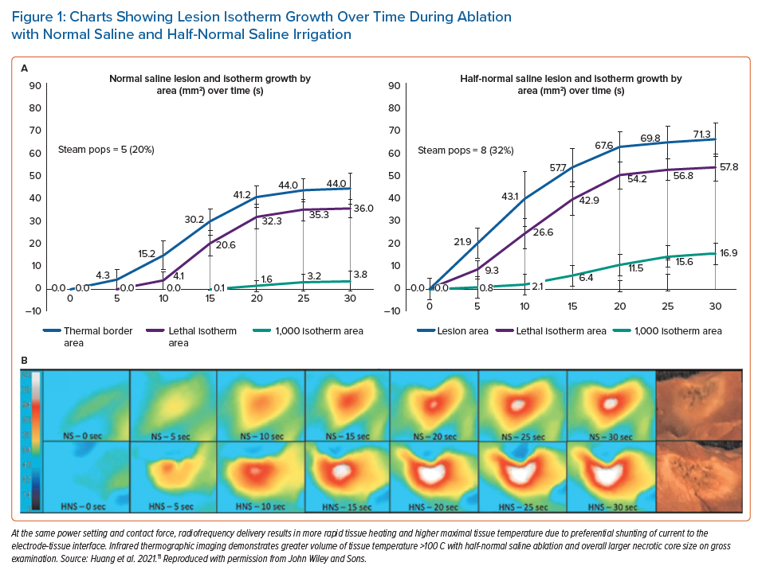
Ravi V, Winterfield J, Liang JJ, Larsen T, Dye C, Sanders D, Skeete J, Payne J, Trohman RG, Aksu T, Sharma PS, Huang HD
Charts Showing Lesion Isotherm Growth Over Time During Ablation with Normal Saline and Half-Normal Saline Irrigation
Citation: Arrhythmia & Electrophysiology Review 2023;12:e04.
https://doi.org/10.15420/aer.2022.28

