Slide 1
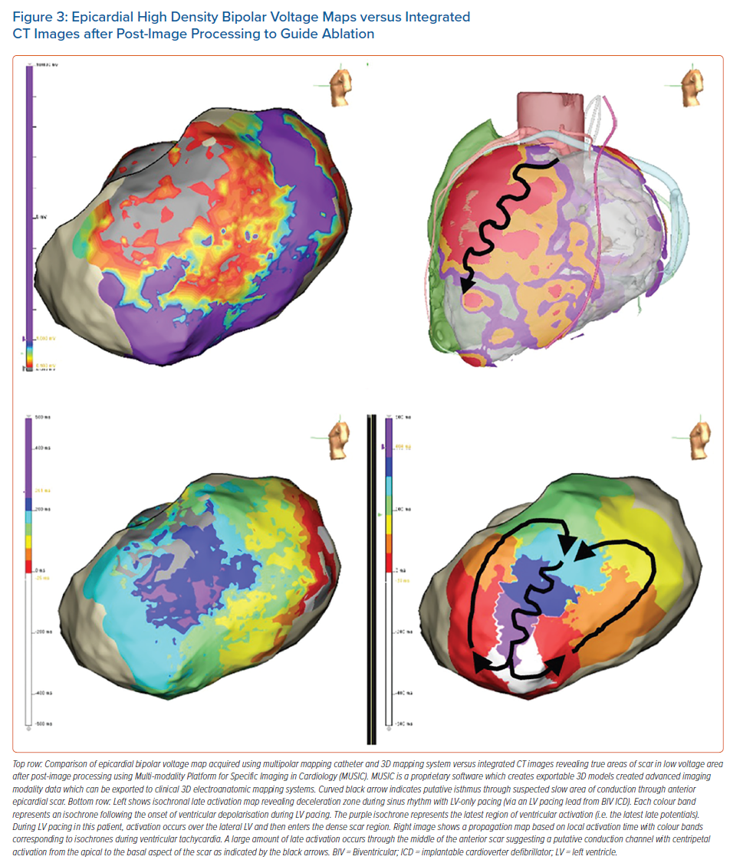
Ravi V, Winterfield J, Liang JJ, Larsen T, Dye C, Sanders D, Skeete J, Payne J, Trohman RG, Aksu T, Sharma PS, Huang HD
Epicardial High Density Bipolar Voltage Maps versus Integrated CT Images after Post-Image Processing to Guide Ablation
Citation: Arrhythmia & Electrophysiology Review 2023;12:e04.
https://doi.org/10.15420/aer.2022.28

