Slide 1
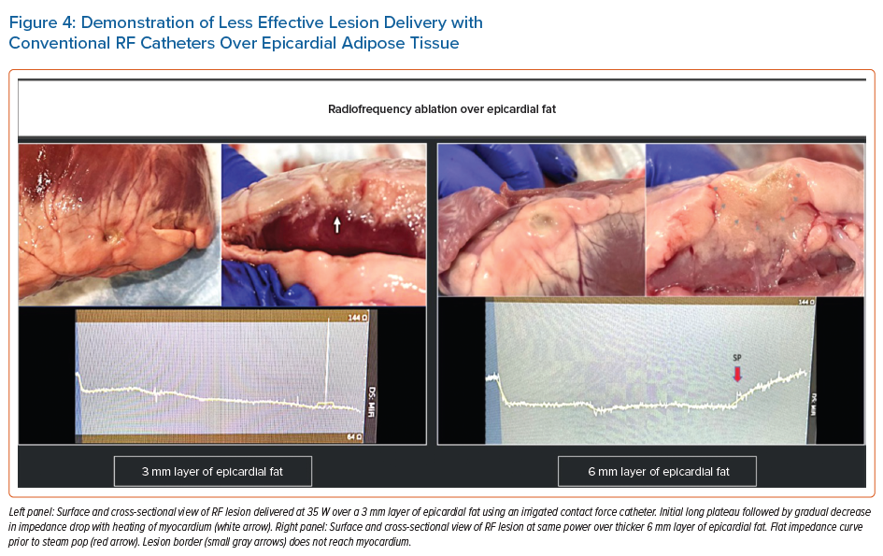
Ravi V, Winterfield J, Liang JJ, Larsen T, Dye C, Sanders D, Skeete J, Payne J, Trohman RG, Aksu T, Sharma PS, Huang HD
Demonstration of Less Effective Lesion Delivery with Conventional RF Catheters Over Epicardial Adipose Tissue
Citation: Arrhythmia & Electrophysiology Review 2023;12:e04.
https://doi.org/10.15420/aer.2022.28

