Slide 1
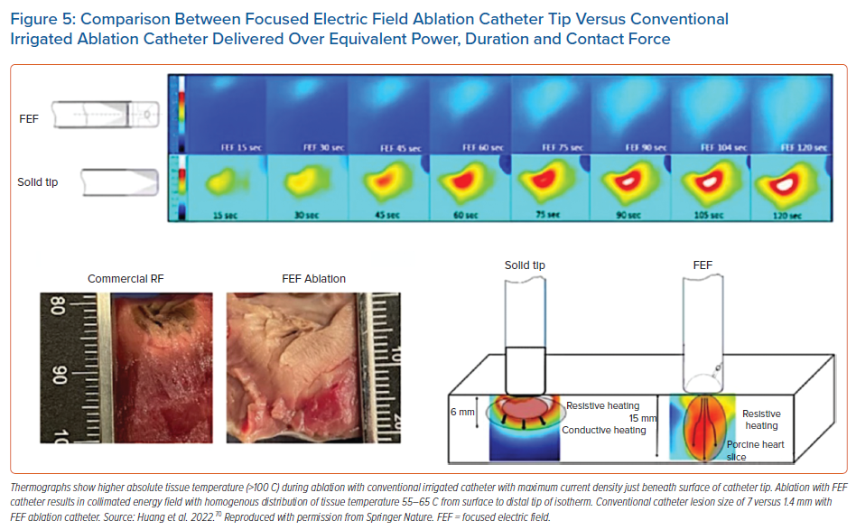
Ravi V, Winterfield J, Liang JJ, Larsen T, Dye C, Sanders D, Skeete J, Payne J, Trohman RG, Aksu T, Sharma PS, Huang HD
Comparison Between Focused Electric Field Ablation Catheter Tip Versus Conventional Irrigated Ablation Catheter Delivered Over Equivalent Power, Duration and Contact Force
Citation: Arrhythmia & Electrophysiology Review 2023;12:e04.
https://doi.org/10.15420/aer.2022.28

