Slide 1
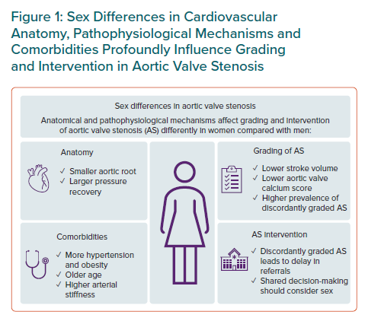
Gerdts E, Midtbø H
Sex Differences in Cardiovascular Anatomy, Pathophysiological Mechanisms and Comorbidities Profoundly Influence Grading and Intervention in Aortic Valve Stenosis
Citation: European Cardiology Review 2023;18:e05.
https://doi.org/10.15420/ecr.2022.52

