Slide 1

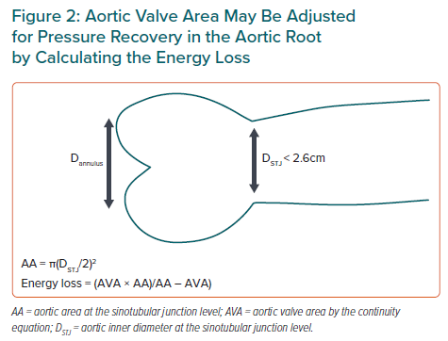
Gerdts E, Midtbø H
Aortic Valve Area May Be Adjusted for Pressure Recovery in the Aortic Root by Calculating the Energy Loss
Citation: European Cardiology Review 2023;18:e05.
https://doi.org/10.15420/ecr.2022.52

