Slide 1
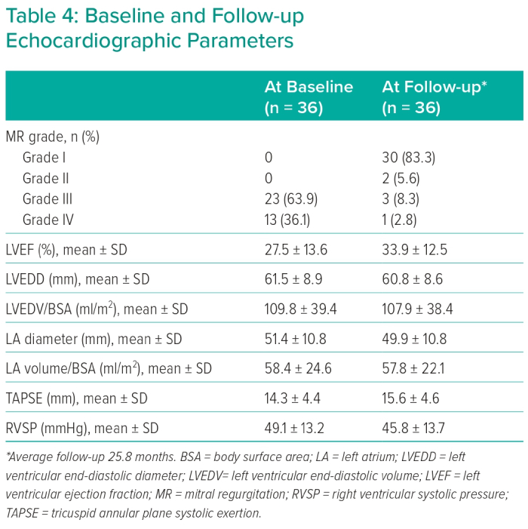
Mohammed HM, Farah A, Plicht B, El-Garhy M, Janicke I, Yousef A, AbdelWahab MA, Taha NM, Schoels W, Buck T
Baseline and Follow-up Echocardiographic Parameters
Citation: Interventional Cardiology 2023;18:e03.
https://doi.org/10.15420/icr.2021.28

