Slide 1
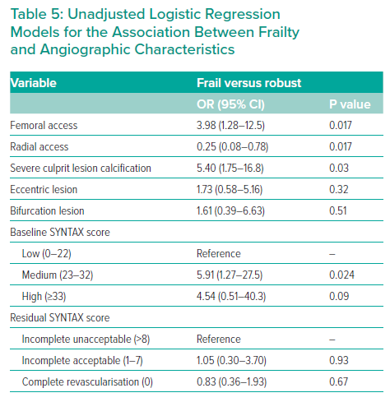
Beska B, Ratcovich H, Bagnall A, Burrell A, Edwards R, Egred M, Jordan R, Khan A, Mills GB, Morrison E, Raharjo DE, Singh F, Wilkinson C, Zaman A, Kunadian V
Unadjusted Logistic Regression Models for the Association Between Frailty and Angiographic Characteristics
Citation: Interventional Cardiology 2023;18:e04.
https://doi.org/10.15420/icr.2022.20

