Slide 1
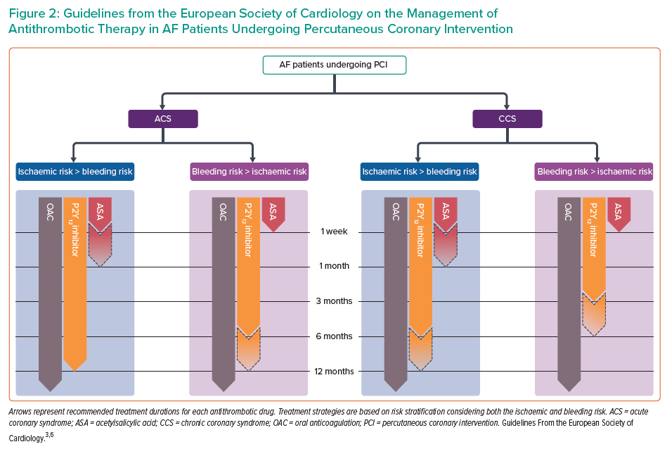
Greco A, Laudani C, Rochira C, Capodanno D
Guidelines from the European Society of Cardiology on the Management of Antithrombotic Therapy in AF Patients Undergoing Percutaneous Coronary Intervention
Citation: Interventional Cardiology 2023;18:e05.
https://doi.org/10.15420/icr.2021.30

