Slide 1
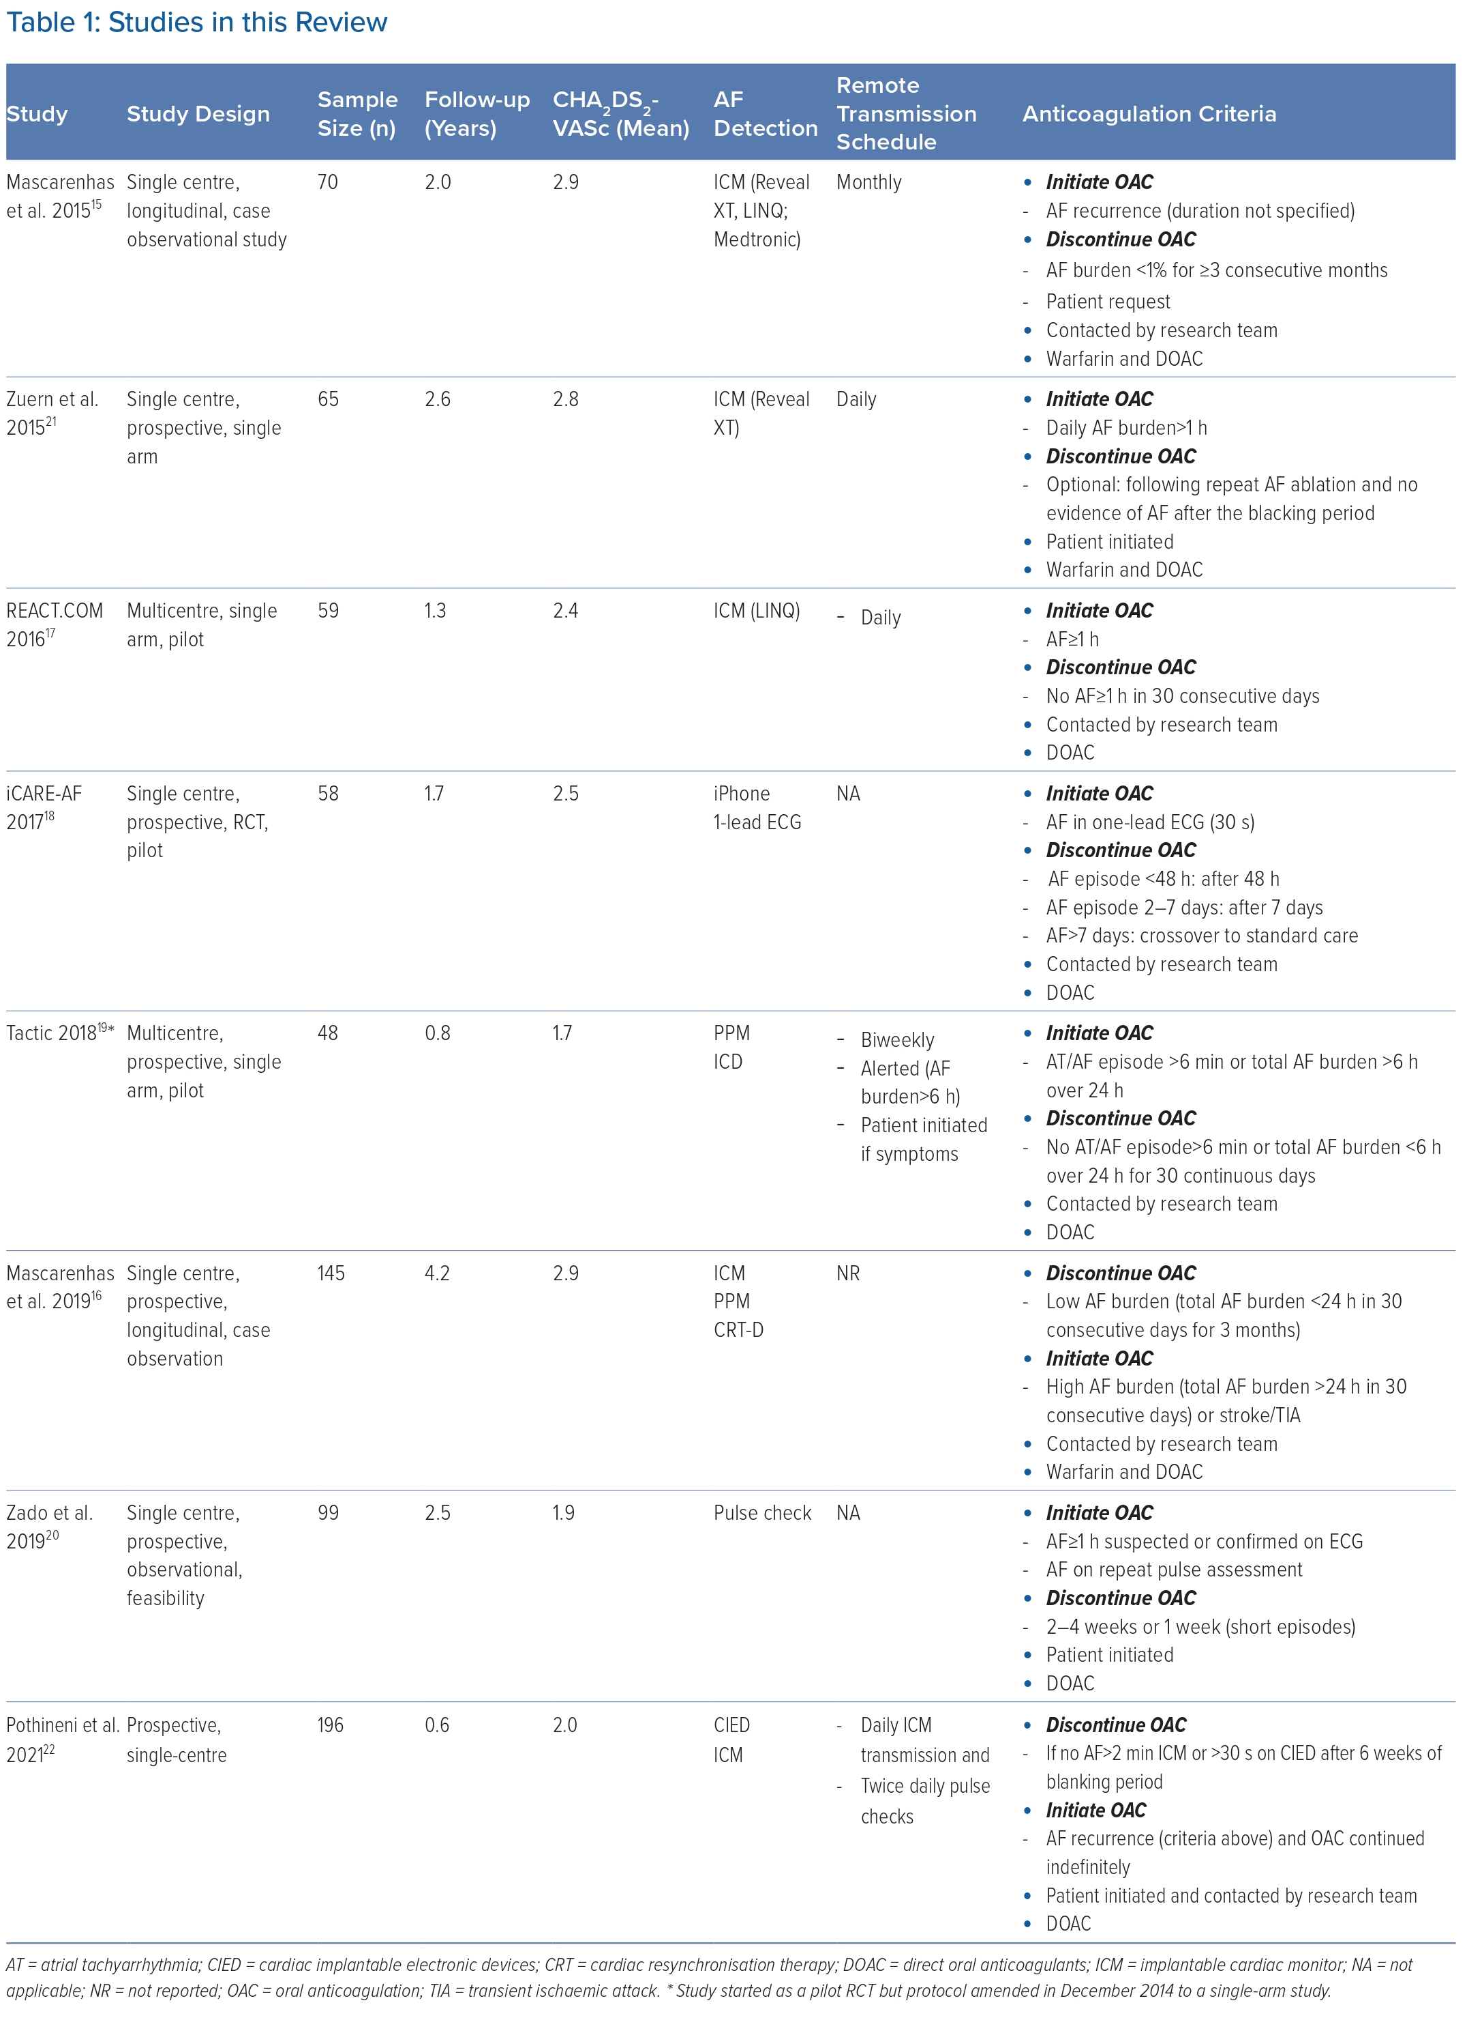
Gala ABe, Pope MTB, Leo M, Sharp AJ, Tsoi V, Paisey J, Curzen N, Betts TR
Studies in this Review
Citation: Arrhythmia & Electrophysiology Review 2023;12:e05.
https://doi.org/10.15420/aer.2022.22

