Slide 1
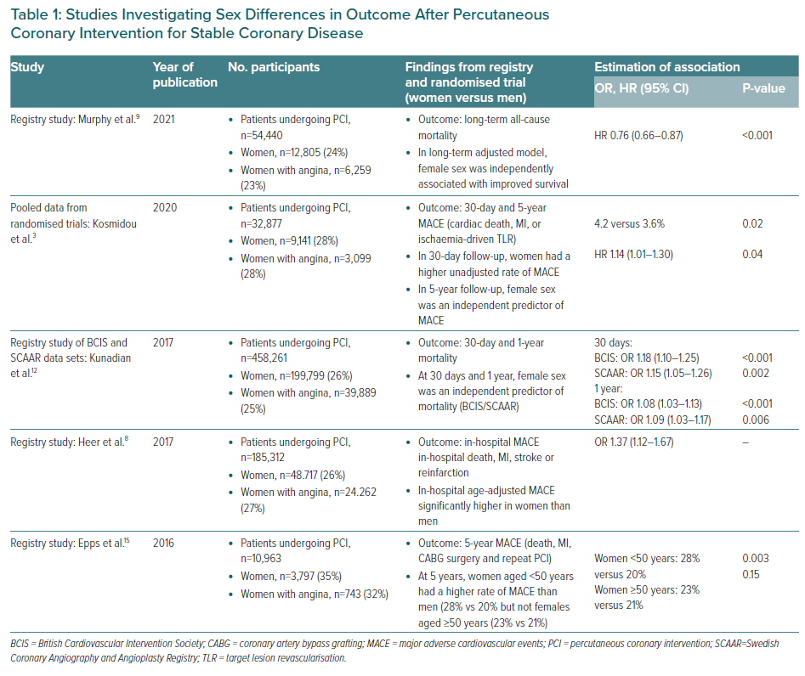
Sambola A, Blanco BGD, Kunadian V, Vogel B, Chieffo A, Vidal M, Ratcovich H, Botti G, Wilkinson C, Mehran R
Studies Investigating Sex Differences in Outcome After Percutaneous Coronary Intervention for Stable Coronary Disease
Citation: European Cardiology Review 2023;18:e06.
https://doi.org/10.15420/ecr.2022.24

