Slide 1
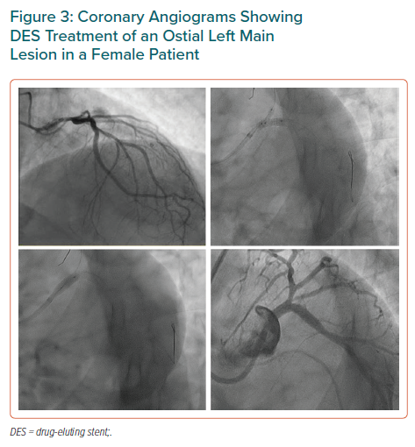
Sambola A, Blanco BGD, Kunadian V, Vogel B, Chieffo A, Vidal M, Ratcovich H, Botti G, Wilkinson C, Mehran R
Coronary Angiograms Showing DES Treatment of an Ostial Left Main Lesion in a Female Patient
Citation: European Cardiology Review 2023;18:e06.
https://doi.org/10.15420/ecr.2022.24

