Slide 1
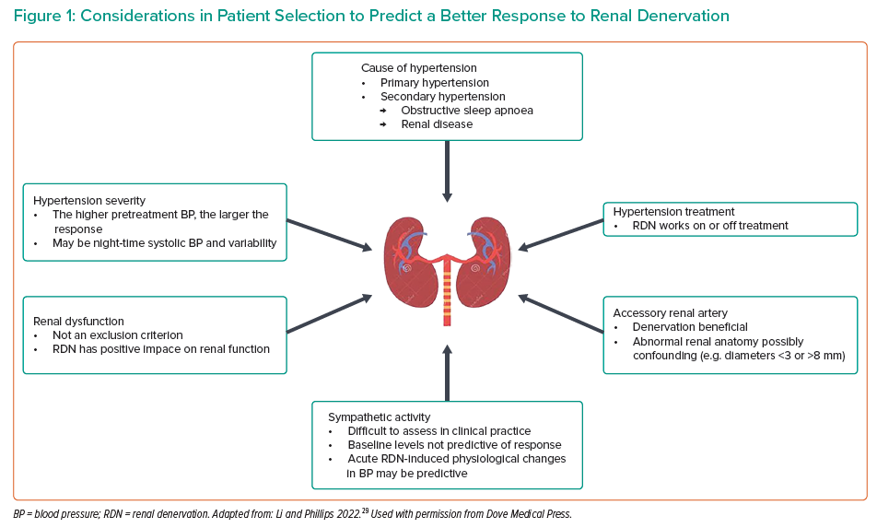
Schmider R, Burnier M, East C, Tsioufis K, Delaney S
Considerations in Patient Selection to Predict a Better Response to Renal Denervation
Citation: Interventional Cardiology 2023;18:e06.
https://doi.org/10.15420/icr.2022.38

