Slide 1
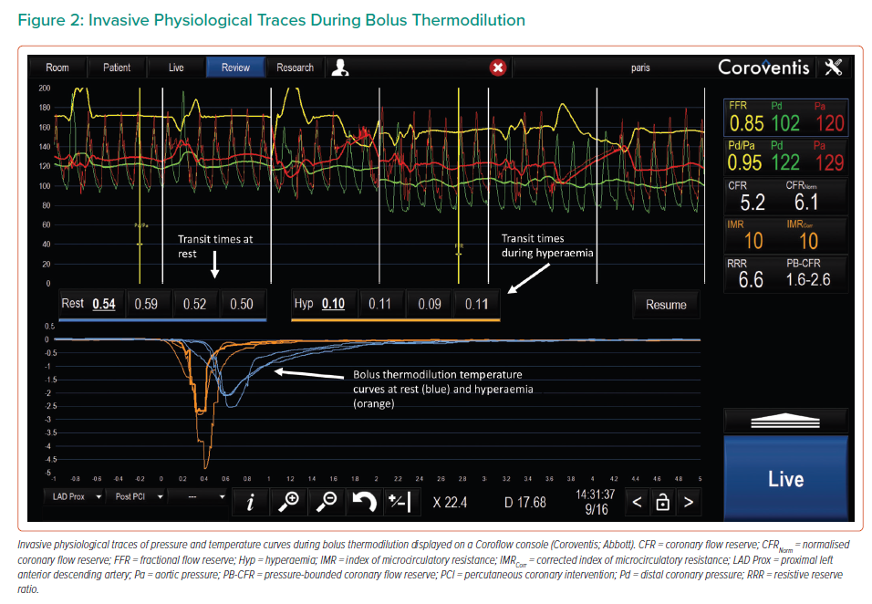
Fawaz S, Khan S, Simpson R, Clesham G, Cook CM, Davies JR, Karamasis GV, Keeble TR
Invasive Physiological Traces During Bolus Thermodilution
Citation: Interventional Cardiology 2023;18:e07.
https://doi.org/10.15420/icr.2022.30

