Slide 1
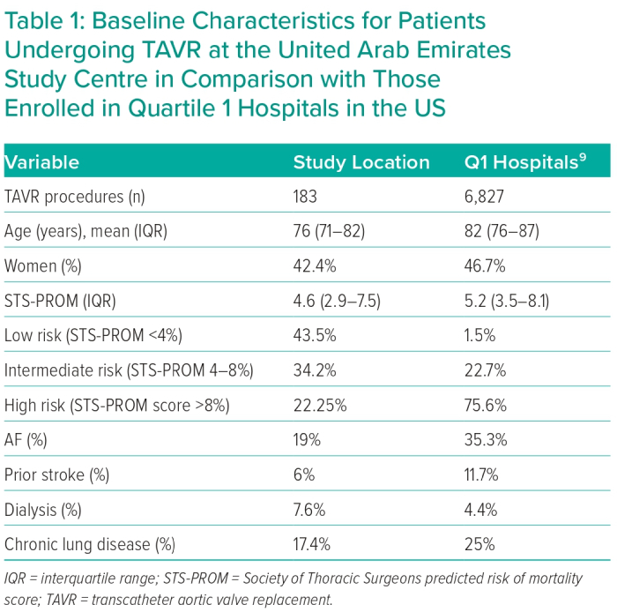
Edris A, Manla Y, Badarin FA, Hasan K, Hashmani S, Traina M, Khiati D, Khalouf A, Zouhbi AE, Tuzcu EM
Baseline Characteristics for Patients Undergoing TAVR at the United Arab Emirates Study Centre in Comparison with Those Enrolled in Quartile 1 Hospitalsin the US
Citation: Interventional Cardiology 2023;18:e08.
https://doi.org/10.15420/icr.2022.04

