Slide 1
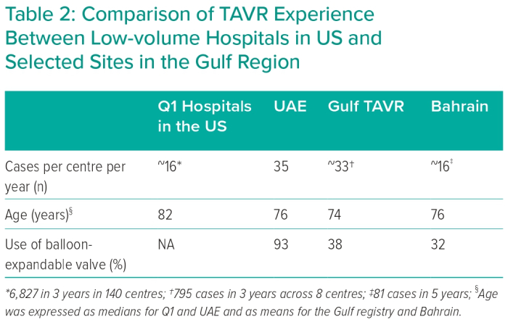
Edris A, Manla Y, Badarin FA, Hasan K, Hashmani S, Traina M, Khiati D, Khalouf A, Zouhbi AE, Tuzcu EM
Comparison of TAVR Experience Between Low-volume Hospitals in US and Selected Sites in the Gulf Region
Citation: Interventional Cardiology 2023;18:e08.
https://doi.org/10.15420/icr.2022.04

