Slide 1
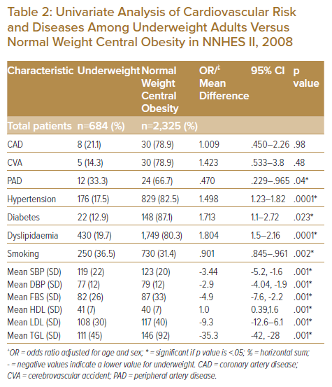
Toledano BRF, Vilela GC
Univariate Analysis of Cardiovascular Risk and Diseases Among Underweight Adults Versus Normal Weight Central Obesity in NNHES II, 2008
Citation: Journal of Asian Pacific Society of Cardiology 2023;2:e03.
https://doi.org/10.15420/japsc.2022.08

