Slide 1
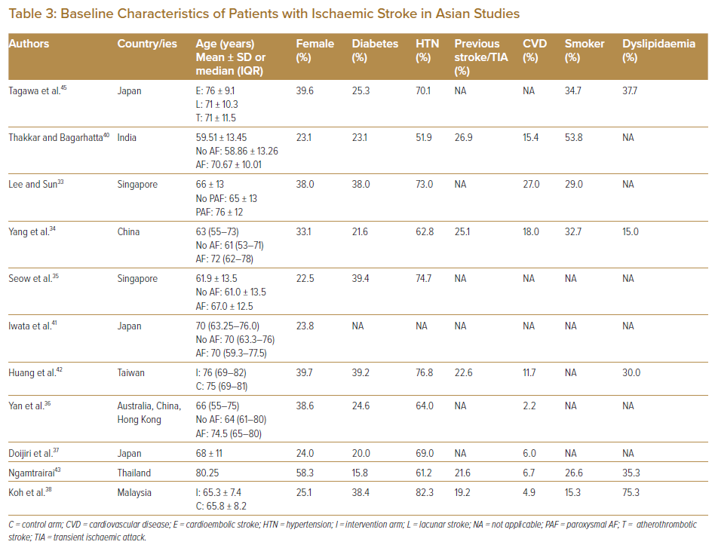
Foo DHP, Fong AYY, Almahmeed W
Baseline Characteristics of Patients with Ischaemic Stroke in Asian Studies
Citation: Journal of Asian Pacific Society of Cardiology 2023;2:e04.
https://doi.org/10.15420/japsc.2021.32

