Slide 1
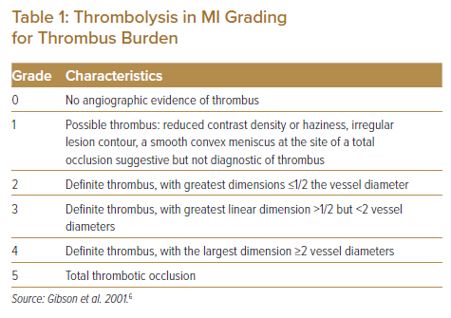
Tsui KL
Thrombolysis in MI Grading for Thrombus Burden
Citation: Journal of Asian Pacific Society of Cardiology 2023;2:e05.
https://doi.org/10.15420/japsc.2022.32

