Slide 1
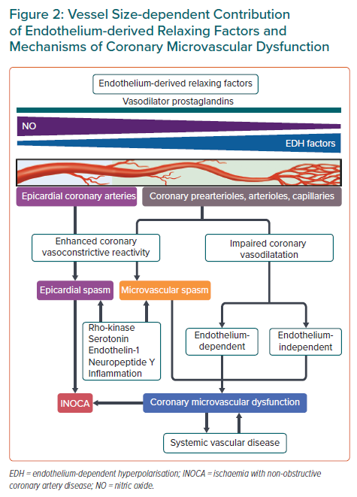
Godo S, Takahashi J, Shiroto T, Yasuda S, Shimokawa H
Vessel Size-dependent Contribution of Endothelium-derived Relaxing Factors and Mechanisms of Coronary Microvascular Dysfunction
Citation: European Cardiology Review 2023;18:e07.
https://doi.org/10.15420/ecr.2022.50

