Slide 1
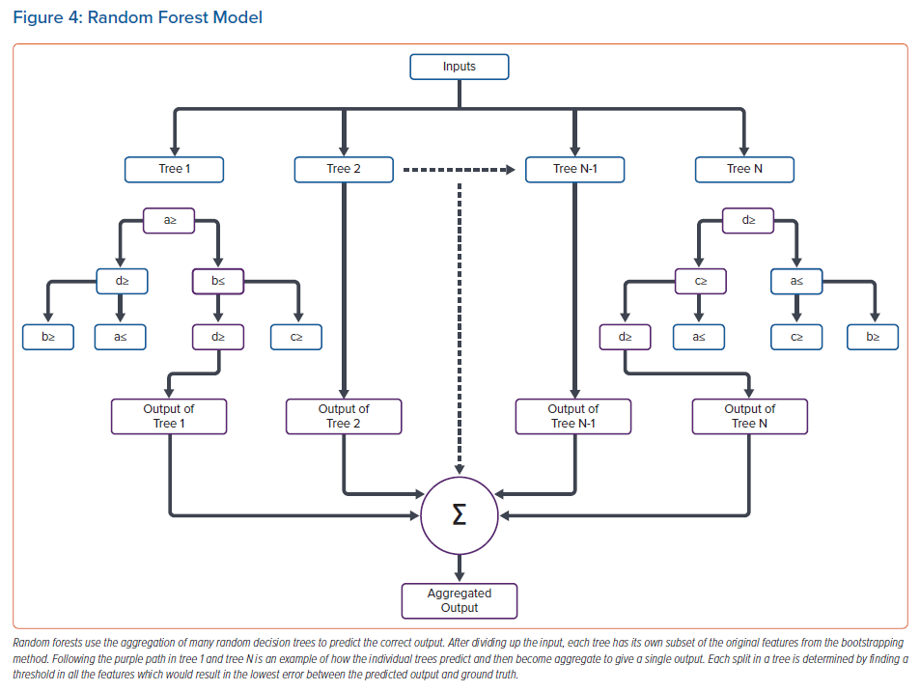
Loeffler SE, Trayanova NA
Random Forest Model
Citation: Arrhythmia & Electrophysiology Review 2023;12:e06.
https://doi.org/10.15420/aer.2022.43

