Slide 1
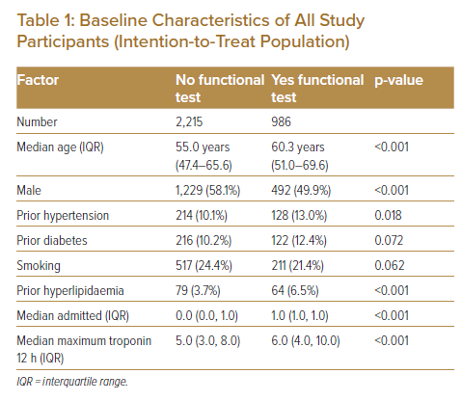
Wattchow N, Lambrakis K, Horsfall M, Morton E, Papendick C, Blyth A, Chew DP
Baseline Characteristics of All Study Participants (Intention-to-Treat Population)
Citation: Journal of Asian Pacific Society of Cardiology 2023;2:e06.
https://doi.org/10.15420/japsc.2021.23

