Slide 1
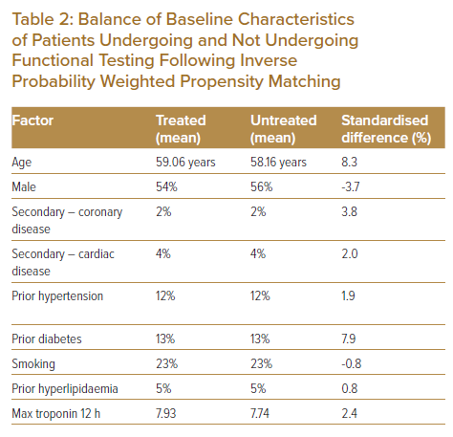
Wattchow N, Lambrakis K, Horsfall M, Morton E, Papendick C, Blyth A, Chew DP
Balance of Baseline Characteristics of Patients Undergoing and Not Undergoing Functional Testing Following Inverse Probability Weighted Propensity Matching
Citation: Journal of Asian Pacific Society of Cardiology 2023;2:e06.
https://doi.org/10.15420/japsc.2021.23

