Slide 1
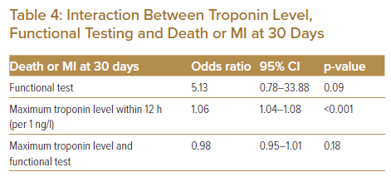
Wattchow N, Lambrakis K, Horsfall M, Morton E, Papendick C, Blyth A, Chew DP
Interaction Between Troponin Level, Functional Testing and Death or MI at 30 Days
Citation: Journal of Asian Pacific Society of Cardiology 2023;2:e06.
https://doi.org/10.15420/japsc.2021.23

